Slide 1

WELCOME

Slide 2

TITLE : Crimes Data Set Analysis Name : Deepti Horakeri Date Submitted : 10/12/2024
TITLE : Crimes Data Set Analysis Name : Deepti Horakeri Date Submitted : 10/12/2024

Slide 3
AIM:
The primary objective of this project is to analyze the given dataframe and derive meaningful insights by visualizing the data through various plots. By implementing different types of data visualizations, the project aims to:
Clean the data set i.e data wriggling.
Identify patterns, trends, and relationships within the dataset.
Summarize the data in a visually interpretable format.
Enhance understanding of the underlying data structure.
Support informed decision-making based on data-driven insights.
This analysis will serve as a foundation for deeper exploration and potential applications of the data.

Slide 4
Problem Statement :
Overview
In many industries, businesses increasingly rely on real-time data to make informed decisions. However, real-time data is often messy, unstructured, and incomplete. This poses significant challenges in cleaning, organizing, and analyzing the data quickly enough to maintain its value. Traditional data management systems and manual interventions struggle to keep pace, leading to delays, inaccuracies, and lost opportunities.
Data Quality: Real-time datasets often contain missing values, duplicates, and inconsistent formats, reducing the reliability of analyses.
Scalability: As data volumes grow rapidly, the systems managing the data struggle to scale efficiently.
Timeliness: Cleaning and preparing the data for analysis is time-consuming, which hinders real-time decision-making.
Integration: Real-time data comes from diverse sources (e.g., IoT devices, social media, transaction systems) and formats, creating integration challenges.

Slide 5
Project Description :
Objective: The project aims to develop an automated, scalable, and efficient system to process, clean, and analyze messy real-time datasets. By addressing these challenges can leverage the full potential of real-time data to make timely and accurate decisions, optimize operations, and enhance people experiences.
Data Cleaning
Real-Time Processing
Insights Generation
Technologies and Methodologies :
Data Cleaning Tools: Python-based libraries (e.g., Pandas DataFrames, numpy ) and custom scripts for automated data quality management.
Machine Learning: a role in the development and evaluation of machine learning algorithms, primarily in the context of statistical analysis and hypothesis testing.
Visualization: Seaborn ,Matplotlib and plotly tools of python are used for visualizations.

Slide 6
Functionalities
Real-Time Data Ingestion
Searching dataset in many web pages and choosing the dataset.
Automated Data Cleaning
Identify and resolve data quality issues like missing values, duplicates, and outliers to maintain data accuracy and reliability.
Scalable Data Processing
Utilize distributed computing frameworks to handle large volumes of data efficiently while ensuring minimal latency.
Anomaly Detection
Detect unusual patterns or discrepancies in the data using machine learning and statistical methods, alerting users to potential issues.

Slide 7
Predictive Analytics
Employ machine learning algorithms to generate predictions, classify data, and provide actionable insights for future decision-making.
Performance Monitoring
Continuously track the system’s performance metrics, such as processing speed, error rates, and resource usage, to ensure optimal operation.
These functionalities ensure the project is comprehensive, user-friendly, and capable of transforming raw, messy real-time data into actionable and valuable information.

Slide 8
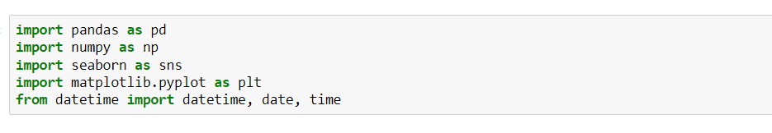
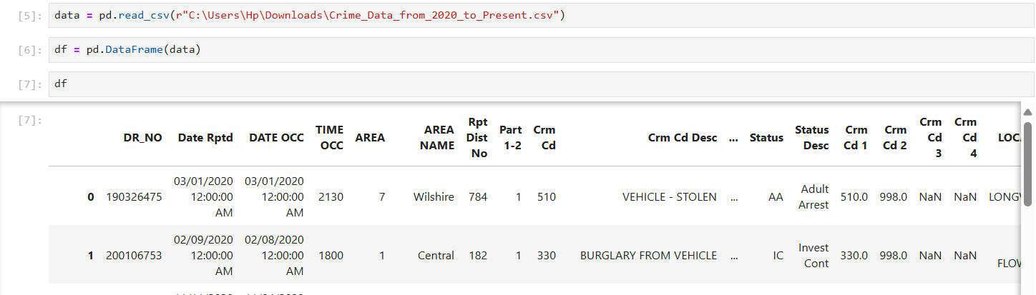
Importing the Modules :
Creating a DataFrame :

Slide 9
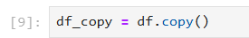
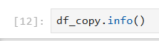
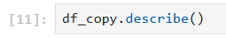
Copying the dataframe :
Information of the Dataset :
Describing the dataset :

Slide 10
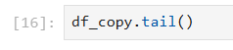
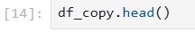
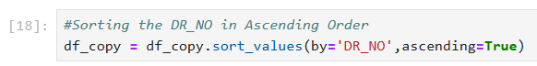
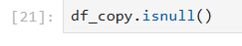
Extracting the above five rows :
Extracting the bottom five rows :
Sorting DR_NO in ascending order :
Checking for null values :

Slide 11
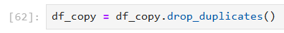
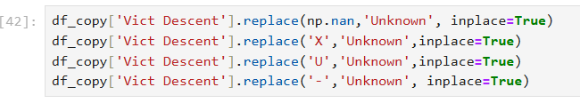
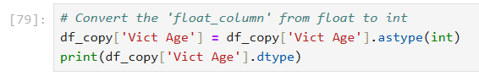
Cleaning The Data :
1.Removing the duplicates :
2.Replacing the Null Values with appropriate Value :
3.Formatting Data :

Slide 12
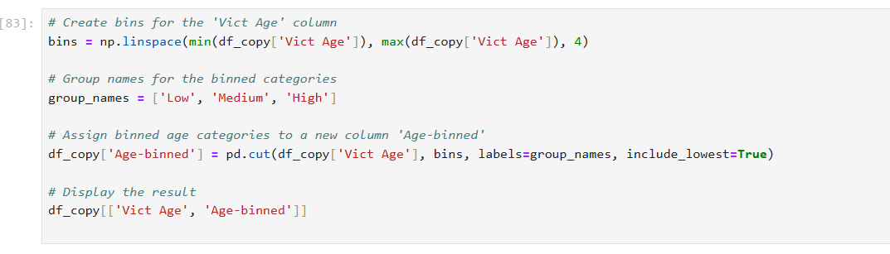
Binning :

Slide 13
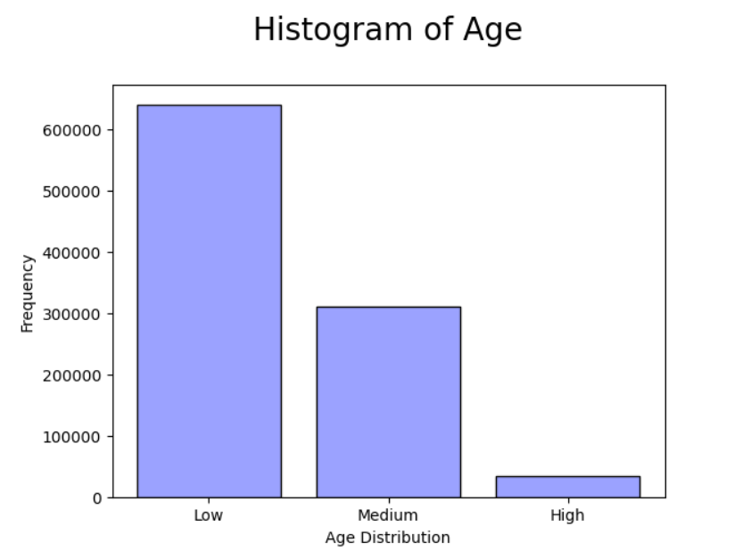
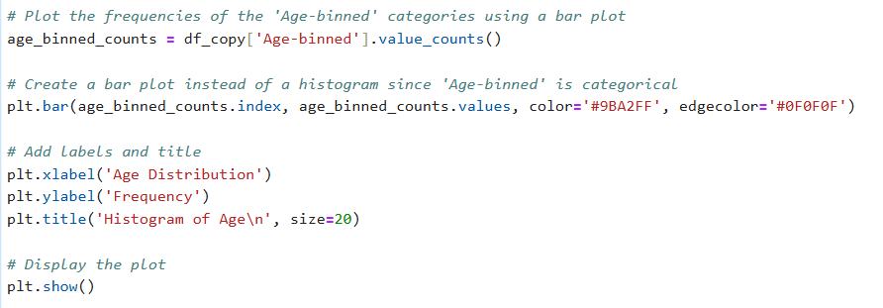
Plot of Histogram :

Slide 14
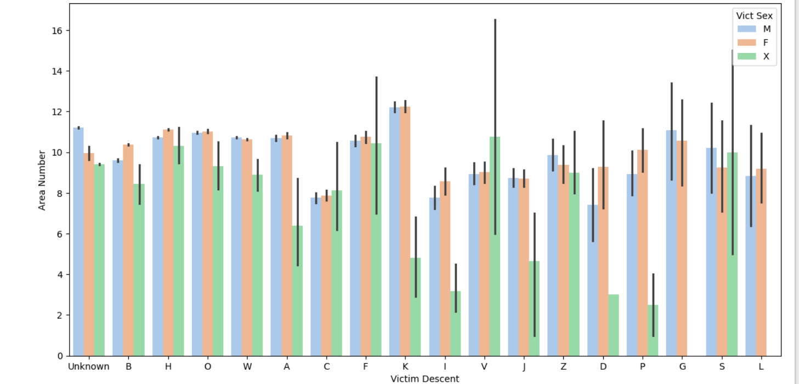
Plot of Area Number v/s Victim Descent :

Slide 15
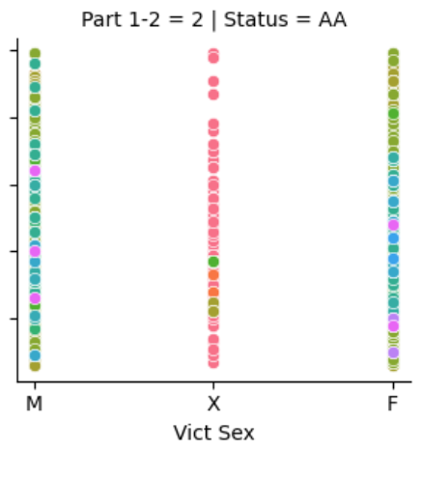
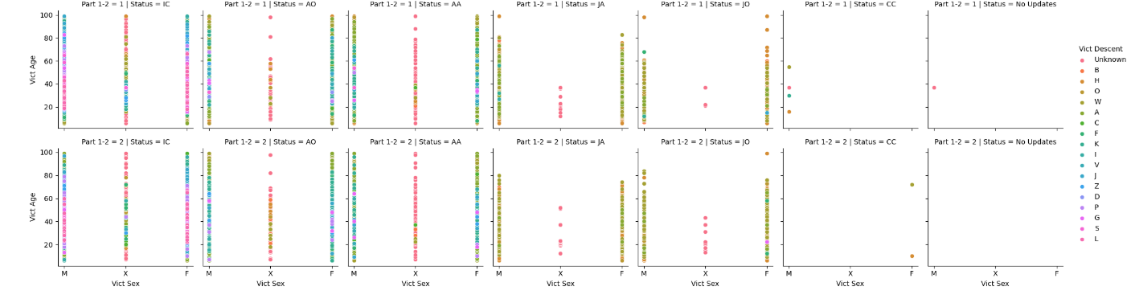
Plot of FacetGrid for Status of Victims

Slide 16
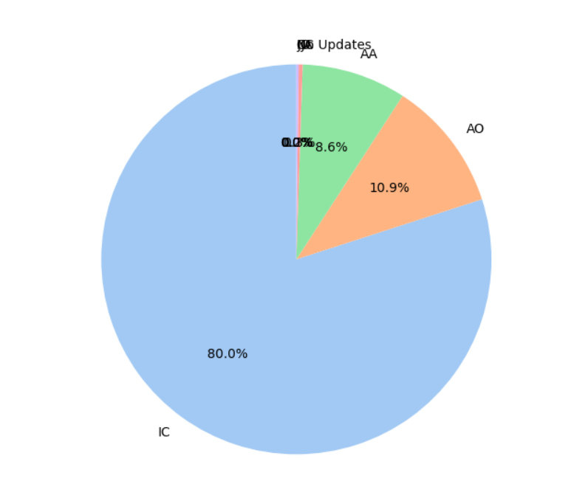
Pie Chart of the various Status of victims

Slide 17
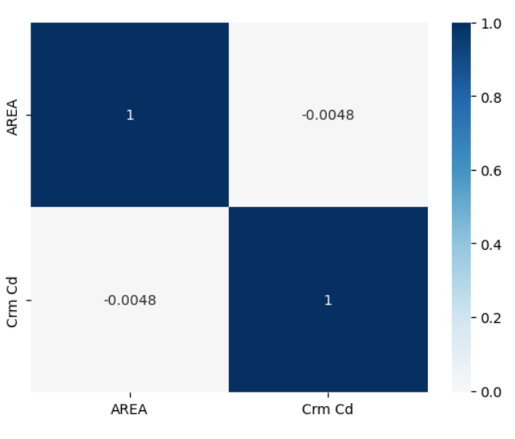
Heat Map for Area and Crime Code

Slide 18
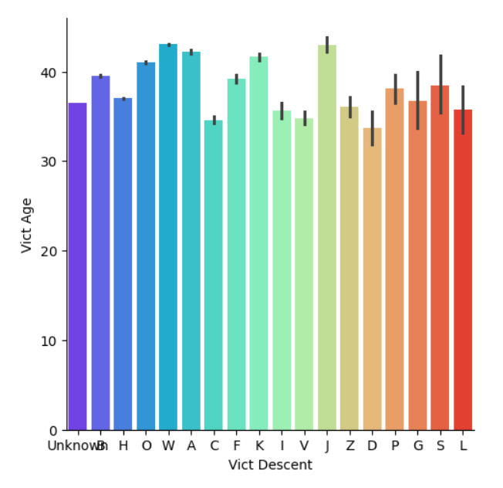
Catplot for Victim Descent verses Age

Slide 19
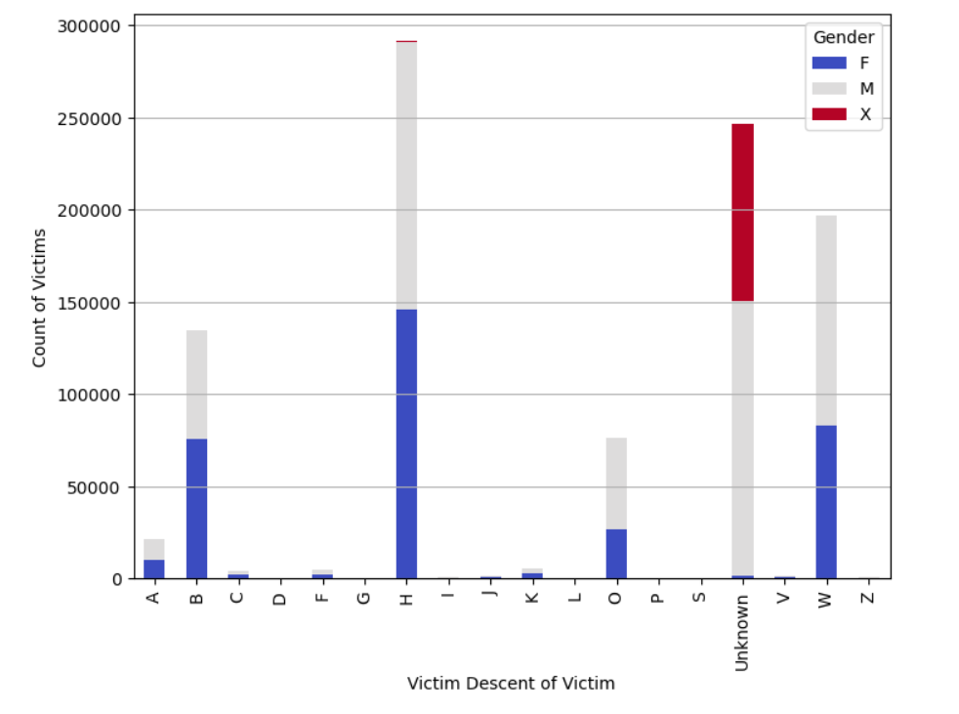
Stacked Bar Plot: Victims by Victim Descent and Gender

Slide 20
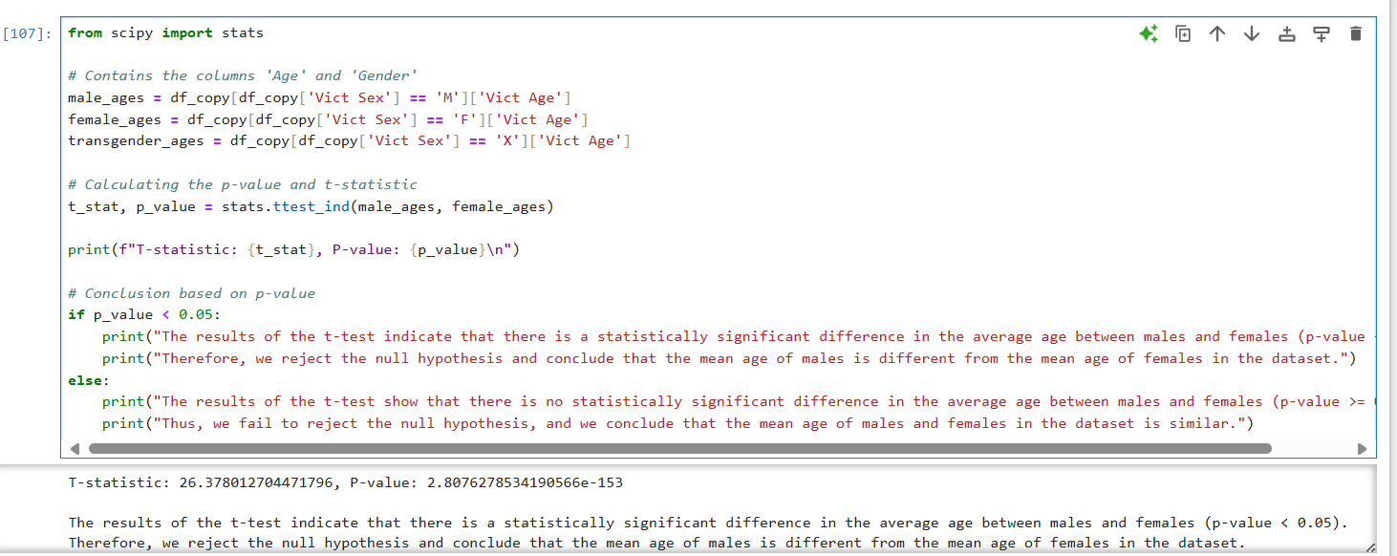
Anova Test :

Slide 21
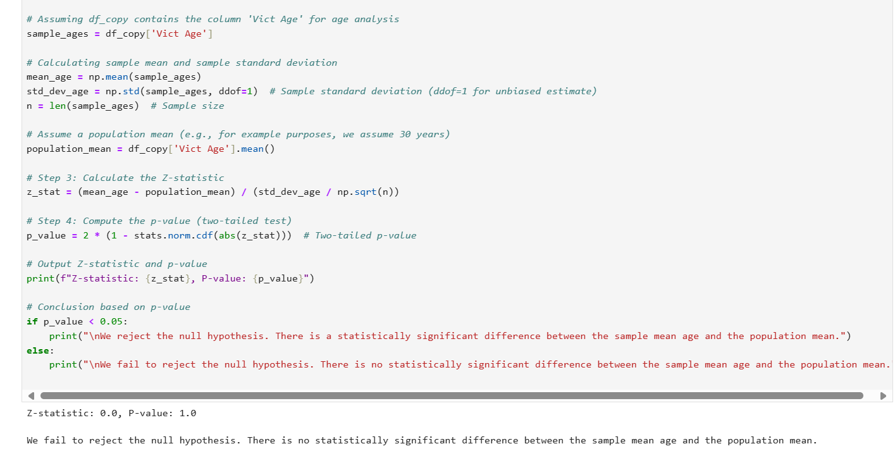
Z-test :

Slide 22

Thank You

